Slide 1
Future of IT
Michael Dempewolf
Ph.D. Information Technology
Senior Software Engineer - Cartegraph
January 20, 2022
Notes:
Hello, my name is Michael Dempewolf.
I am a Senior Software Engineer at Cartegraph, located in Key West. We develop software for municipalities and campuses to manage their assets.
I have been in the industry for +25 years.
I recently was an Assistant Professor of Computer Science at Clarke University.
I have a Ph.D. in Information Technology.
My topic today is the Future of IT.
I gave a similar presentation 4 ½ years ago here at NICC in August 2017.
Let’s take a quick look at the agenda for today …

Slide 2
Agenda
Look back: Review last predictions
Look ahead: Predictions 5 -10 years
IT’s Role
Question/Answer
Notes:
This is a big topic …
So I am going to narrow our scope …
We will look back at the predictions from the experts from 5 years agao
We will look ahead at the next 5 -10 years based on the expert’s predictions
Then we will have a high-level discussion regarding IT’s role
We will finish with a question/answer session

Slide 3

2017 Predictions
This Photo by Unknown Author is licensed under CC BY-ND
Notes:
Let’s start by looking back at what the experts predicted in 2017.

Slide 4
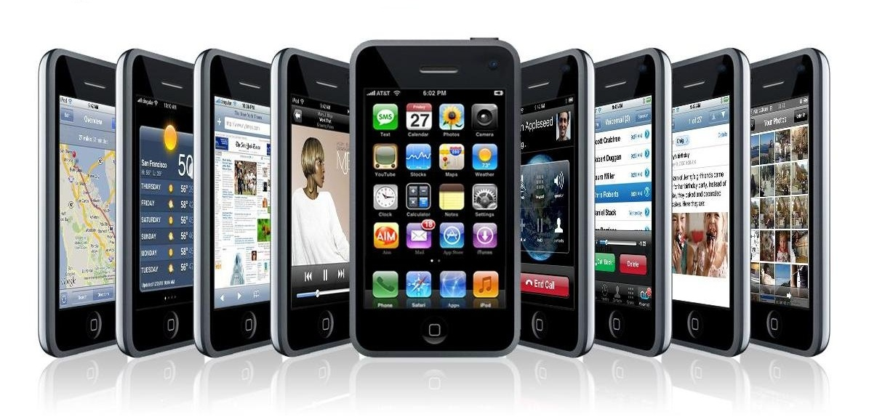
2017 Predictions: Mobile
Flexible
Wearable
Payments
5G Networks
Translation
Batteries
Notes:
Back in 2017, experts said Mobile was still king … and growing.
Predicted:
Cisco predicts there will be 11.6 billion connected devices by 2020 with over 5.5 billion users (70% world population)
Actual:
14.2 billion in 2020, 14.9 billion connected devices in 2021. There were 6.065 billion users in 2020, 6.38 billion users in 2021
Sources:
https://www.statista.com/statistics/245501/multiple-mobile-device-ownership-worldwide/
https://www.statista.com/statistics/218984/number-of-global-mobile-users-since-2010/
Predicted:
US mobile traffic alone will reach 2.9 exabytes per month by 2020. 2.9 exabytes = streaming 725 million DVDs each month.
Actual:
3.09 exabytes per month in 2020, 5.02 exabytes in 2021
Source:
https://www.statista.com/statistics/1133837/north-america-monthly-data-traffic/
Future Prediction 2025:
18.22 billion devices
7.49 billion mobile users
17.18 exabytes per month
Source: same as above

Slide 5
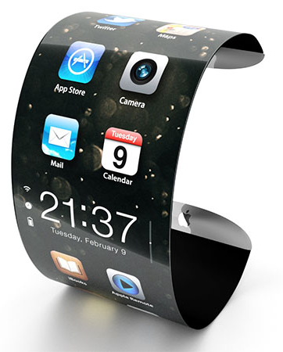
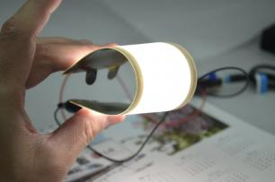
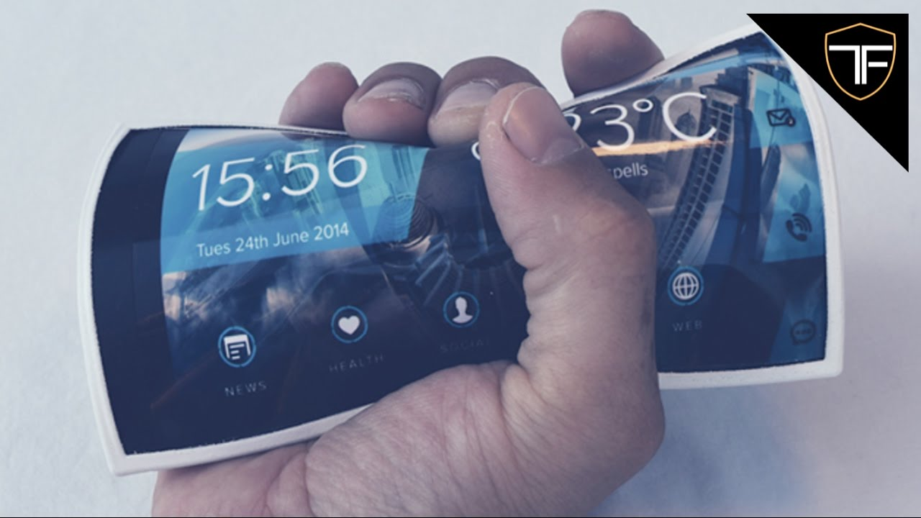
2017 Predictions: Flexible
Notes:
Predicted
Flexible mobile devices:
Using OLED technology. Provides flexible displays and lighting panels. OLED can be plastic, metal, or glass. The plastic and metal variants are incredibly bendable and virtually shatter proof.
First generation – manufacturers create displays which are curved.
Second generation – users will be able to bend the displays.
The technology will culminate in a display which can be bent, folded, or even stretched.
Sources:
https://www.oled-info.com/flexible-oled
Actual:
Curved televisions and monitors, foldable phones (1st Generation)

Slide 6
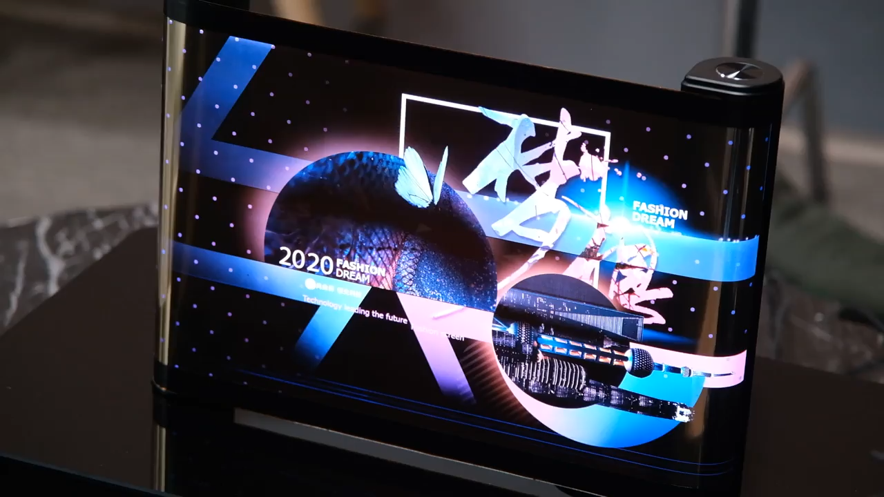
2nd generation Flexible Displays
Notes:
Prototypes exists for 2nd Generation.
https://www.wired.com/story/future-of-phone-design-ces-2021/

Slide 7
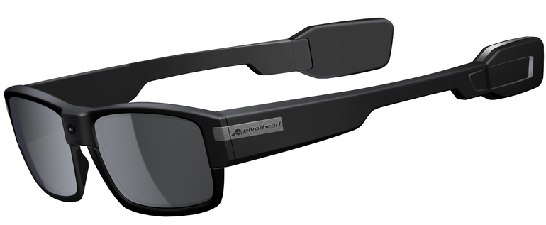
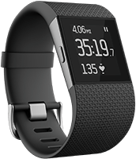
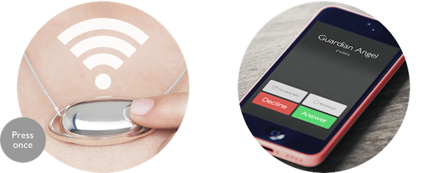
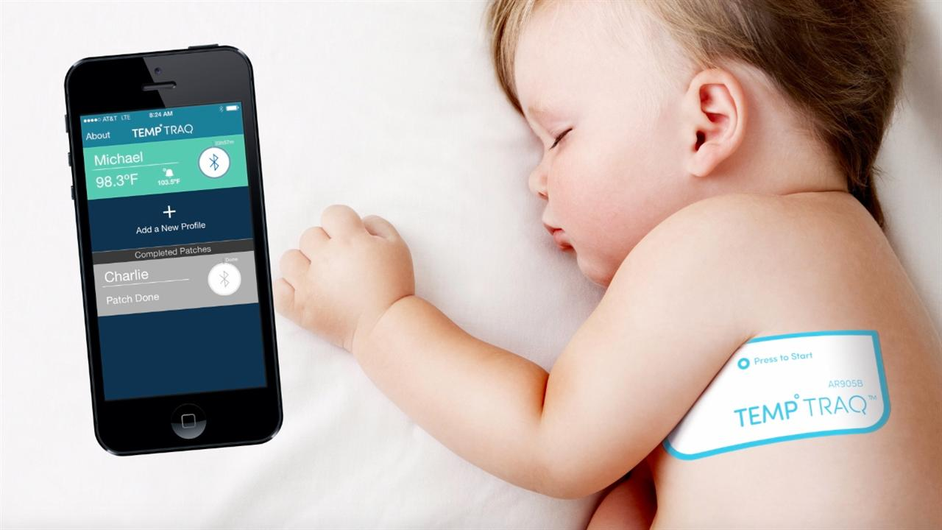
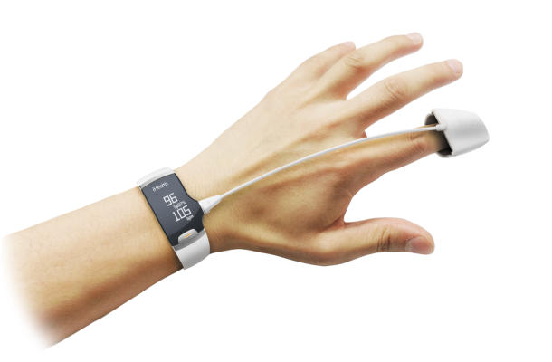
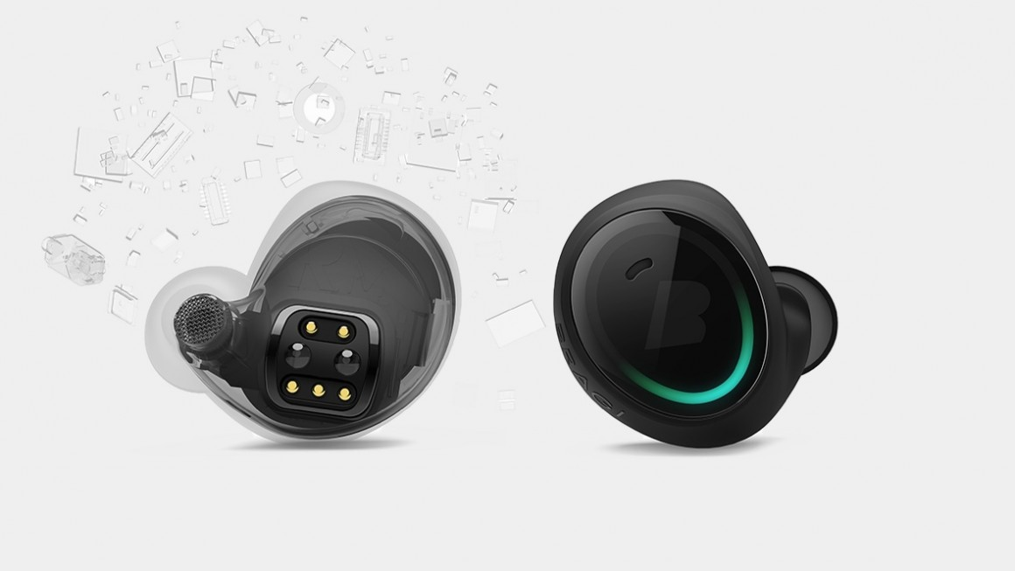
2017 Predictions: Wearables
Notes:
Predictions:
Wearable technologies:
From smartphones to medical devices, wearable tech will transform the way we interact with technology.
Forbes predicted wearable tech market would be worth $34 billion by 2020
IDS predicted 323.6 million users would be using wearable tech by 2020
CSS Insights predicted the following:
Categories:
Wristband 164 million
Eyewear 97 million
Hearables 9 million
Wearable cameras 25 million
Watches 110 million
Tokens, Jewelry, and Clip ons 4 million
Other 2 million
Wearables will be used in numerous ways ranging from fitness to sports to fashion to augmentation to medical.
Cellular connection and innovations will ultimately free wearables from smartphones
Sources:
https://www.forbes.com/forbes/welcome/?toURL=https://www.forbes.com/sites/paullamkin/2016/02/17/wearable-tech-market-to-be-worth-34-billion-by-2020/&refURL=https://www.google.com/&referrer=https://www.google.com/
http://www.idc.com/getdoc.jsp?containerId=prUS41530816
Actual:
The number of connected wearable devices worldwide has more than doubled in the space of three years, increasing from 325 million in 2016 to 722 million in 2019. The number of devices is forecast to reach more than one billion by 2022.
Source: https://www.statista.com/statistics/487291/global-connected-wearable-devices/
Apples Wearable by the numbers:
2019 - $24.4 billion
2020 - $30.5 billion
2021 – $38.3 billion
https://www.businessofapps.com/data/apple-statistics/
Significant growth in Smart Watches, wireless headphones, medical: heart monitors, monitor blood (diabetics), sleep trackers, cardio trackers, blood oxygen levels, etc.)

Slide 8

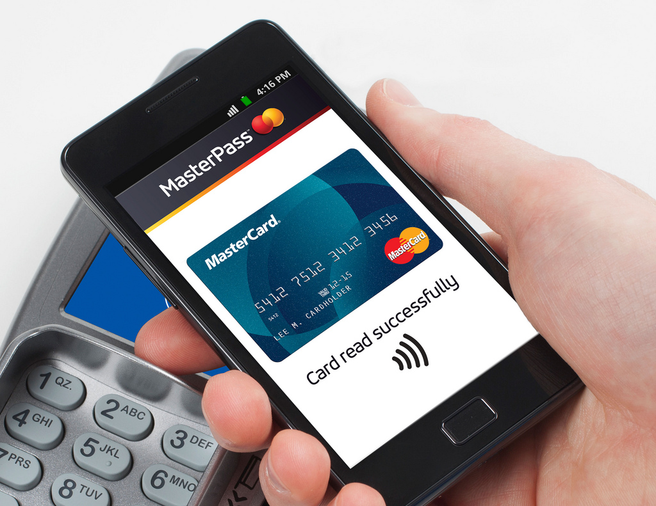
2017 Predictions: Payments
Notes:
Predictions:
Many experts agreed, mobile payments would become the standard by 2020.
PayBefore estimated mobile payments would reach $410.5 billion by 2020
eMarketer noted just 19.4% of smartphone users currently use mobile payments. That number will rise to 33.1% by 2020.
Challenges:
Security concerns
Slow adoption rate of mobile payment by vendors
Disparity in mobile payments apps and vendor support
Sources:
http://paybefore.com/pay-news/study-mobile-payments-to-reach-410-5-billion-by-2020-as-m-wallets-flood-market/
https://www.emarketer.com/Article/Mobile-Payments-US-Growing-Fast-Still-Far-Mass-Adoption/1014689
Actual:
Pandemic brought an explosion in usage. Largest increase of touchless payments in history.
$1.92 trillion in mobile wallet sales in 2020, $2.4 trillion in 2021
https://techcrunch.com/2021/04/05/fueled-by-pandemic-contactless-mobile-payments-to-surpass-half-of-all-smartphone-users-in-u-s-by-2025/
29.3% digital wallets in North America
https://www.statista.com/topics/982/mobile-payments/#dossierKeyfigures

Slide 9

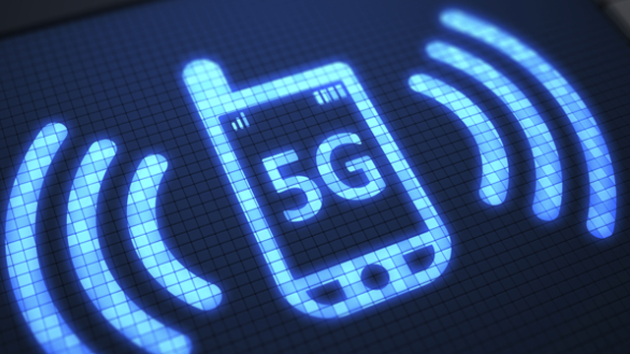
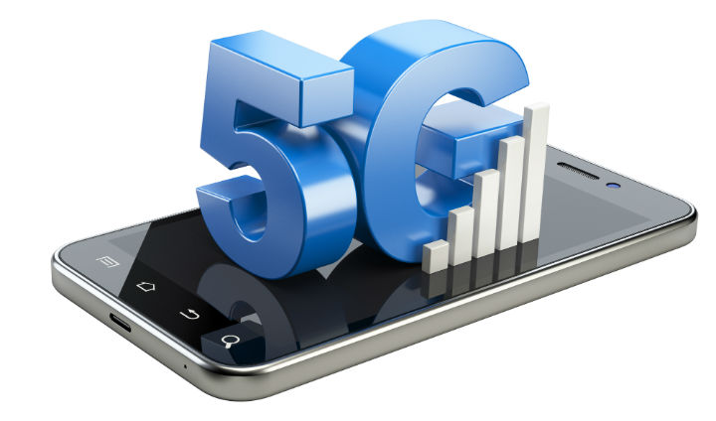
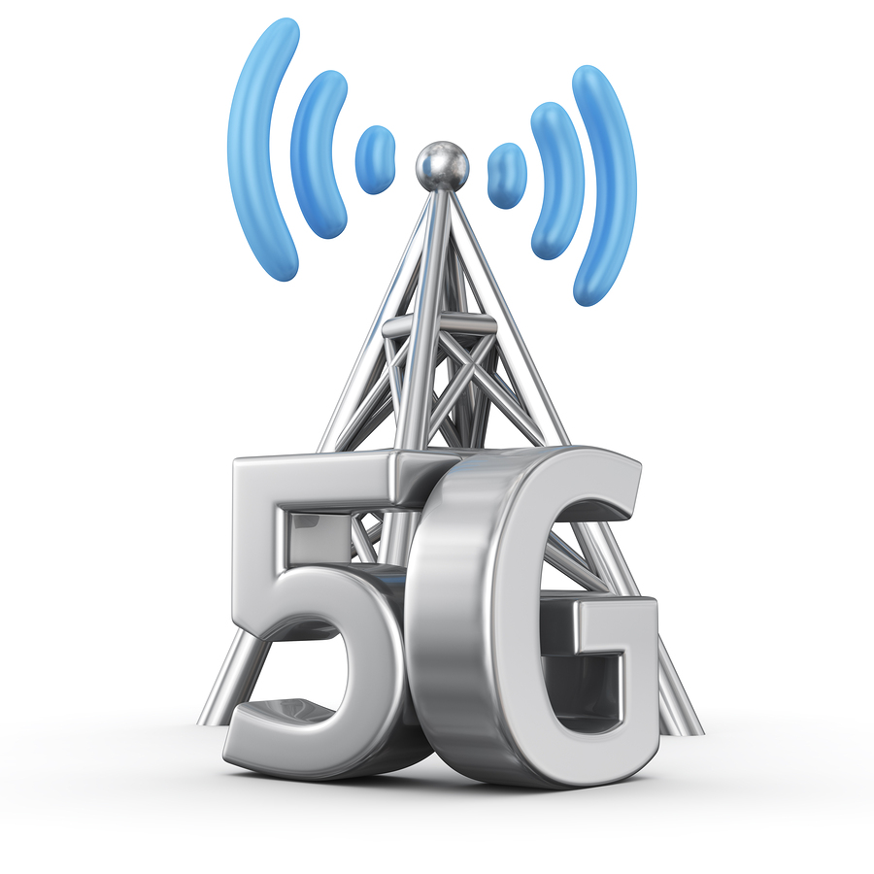
2017 Predictions: 5g
Actual Speeds
Notes:
Prediction: Most experts agreed – 5G would be made available by 2020 (not everyone would have it right away). 5G modems were available at the time. Cellular carriers were gearing up now to make it ready.
The challenges:
No hardware standards, yet
5G will operate in what is known as the millimeter wave (30 GHz – 300 GHz)
Great for transferring large amounts of data
Require shorter distances -> more antennas, lots more antennas
More difficult to get around obstacles, walls, buildings
The benefits?
More speed, lots more speed! How much? It is hard to say at this stage as the standards are still being decided. Currently expected to be 100 times faster than 4G LTE
Examples:
Download the entire Lord of the Rings movies in seconds.
Live VR stream with little or no lag
Support many more devices -> IoT
Sources:
https://www.engadget.com/2017/05/02/t-mobile-plans-national-5g-network-by-2020/
https://www.pcmag.com/article/345387/what-is-5g
https://www.wired.com/2017/02/what-is-5g-and-when-do-i-get-it/
https://www.theregister.co.uk/2013/10/03/ntt_docomo_5g_google_glass_translation/
Actual:
Download capability depends on the device and the carrier. Average 5G download speeds are between 1.4 and 14.3 faster than 4G. The actual number varies from
US 28.9 Mpbs (4G) 50.9 Mpbs (5G) to Saudi Arabia: 28.9 Mpbs (4G) 414.2 Mpbs
https://www.statista.com/statistics/1168439/average-5g-4g-download-speed-comparison/
Let’s look at coverage in the US …

Slide 10
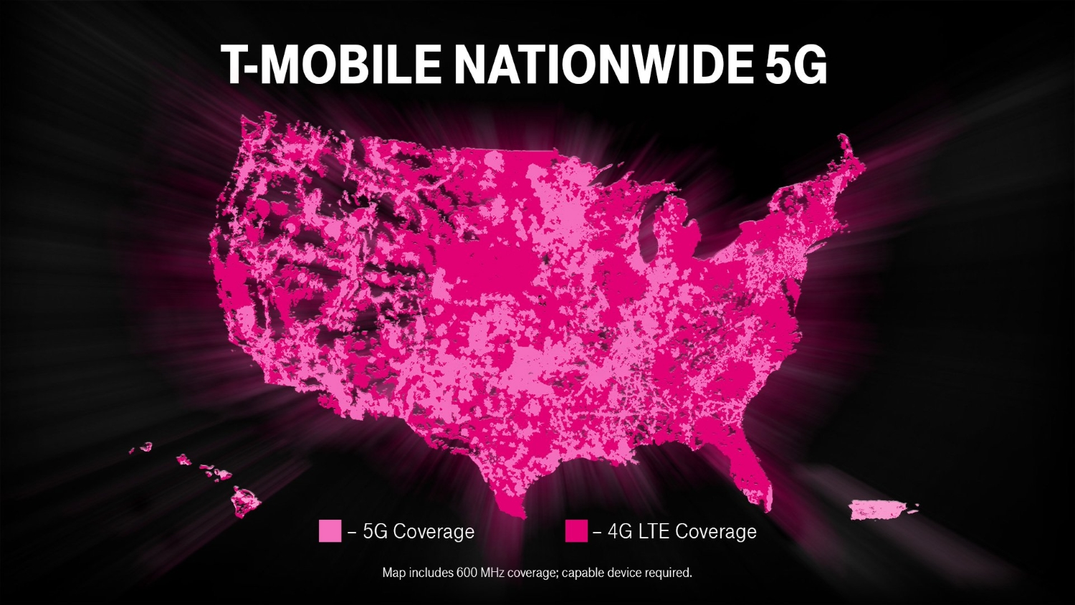
T-Mobile
Notes:
T-Mobile coverage
5G is available in most big cities in the United States. It is slowly spreading into rural areas.
Source: https://www.androidauthority.com/where-is-5g-available-in-the-us-1140484

Slide 11
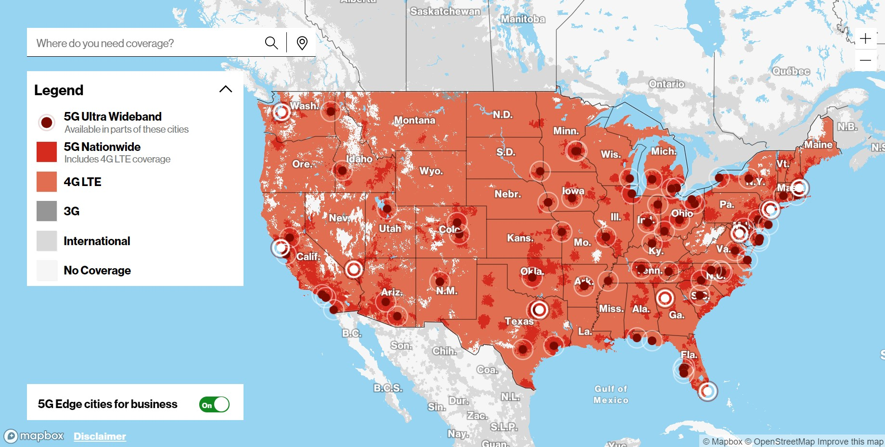
Verizon
Notes:
Verison
Source: https://www.androidauthority.com/where-is-5g-available-in-the-us-1140484

Slide 12
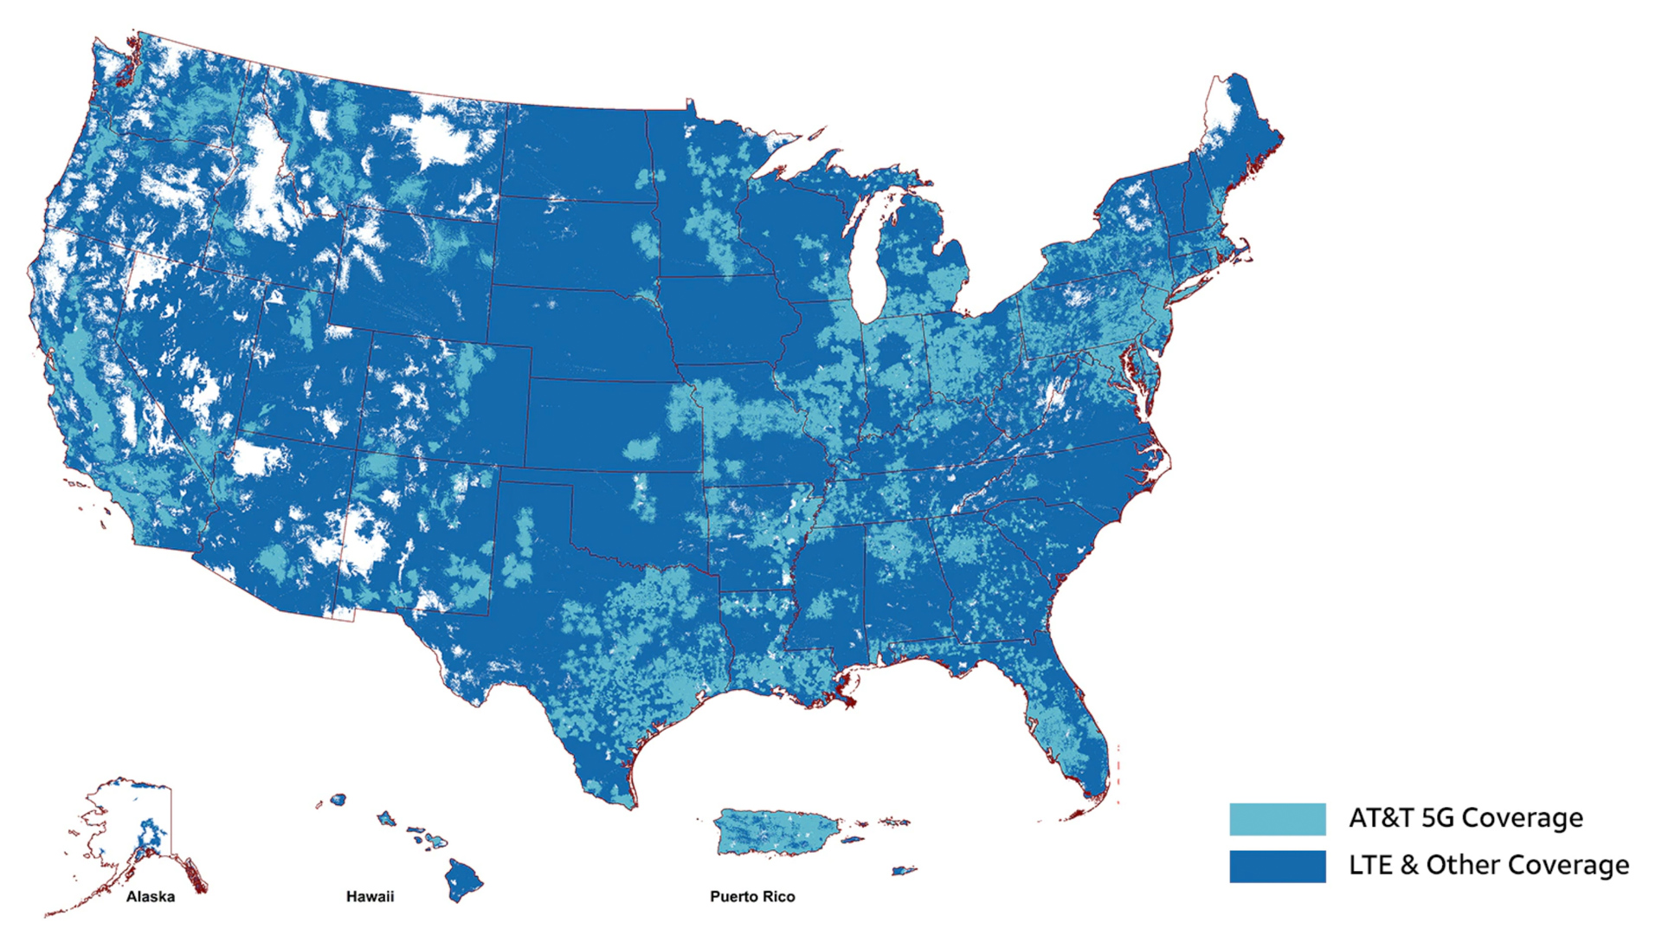
AT&T
Notes:
AT&T
5G is available in most big cities in the United States. It is slowly spreading into rural areas.
Source: https://www.androidauthority.com/where-is-5g-available-in-the-us-1140484/

Slide 13


2017 Predictions: Translation
Notes:
Predictions:
Voice and text translation would be available for the 2020 Tokyo Olympics. The translation would happen in real time without any delay. It would leverage the blazing fast speeds of 5G
and the work of over a decades worth of translation work. The service wpi;d translate between English to Japanese and Japanese to English.
Glasses and touch screens (with the aid of token – such as a special ring) would allow users to view screens based upon their language choice.
Sources:
https://www.theregister.co.uk/2013/10/03/ntt_docomo_5g_google_glass_translation/
http://www.kwintessential.co.uk/blog/interpreting/japanese-automatic-voice-translation-to-impress-at-olympic-games-2020/
Actual:
COVID-19 pandemic disrupted the Olympics
Google has implemented real time translation. Currently have 85% efficiency and takes 2 – 5 seconds.
Other tech giants are also investing in real time translation. We will see rapid advances in this area with the spread of 5G, AI, and Edge computing
Source:

Slide 14
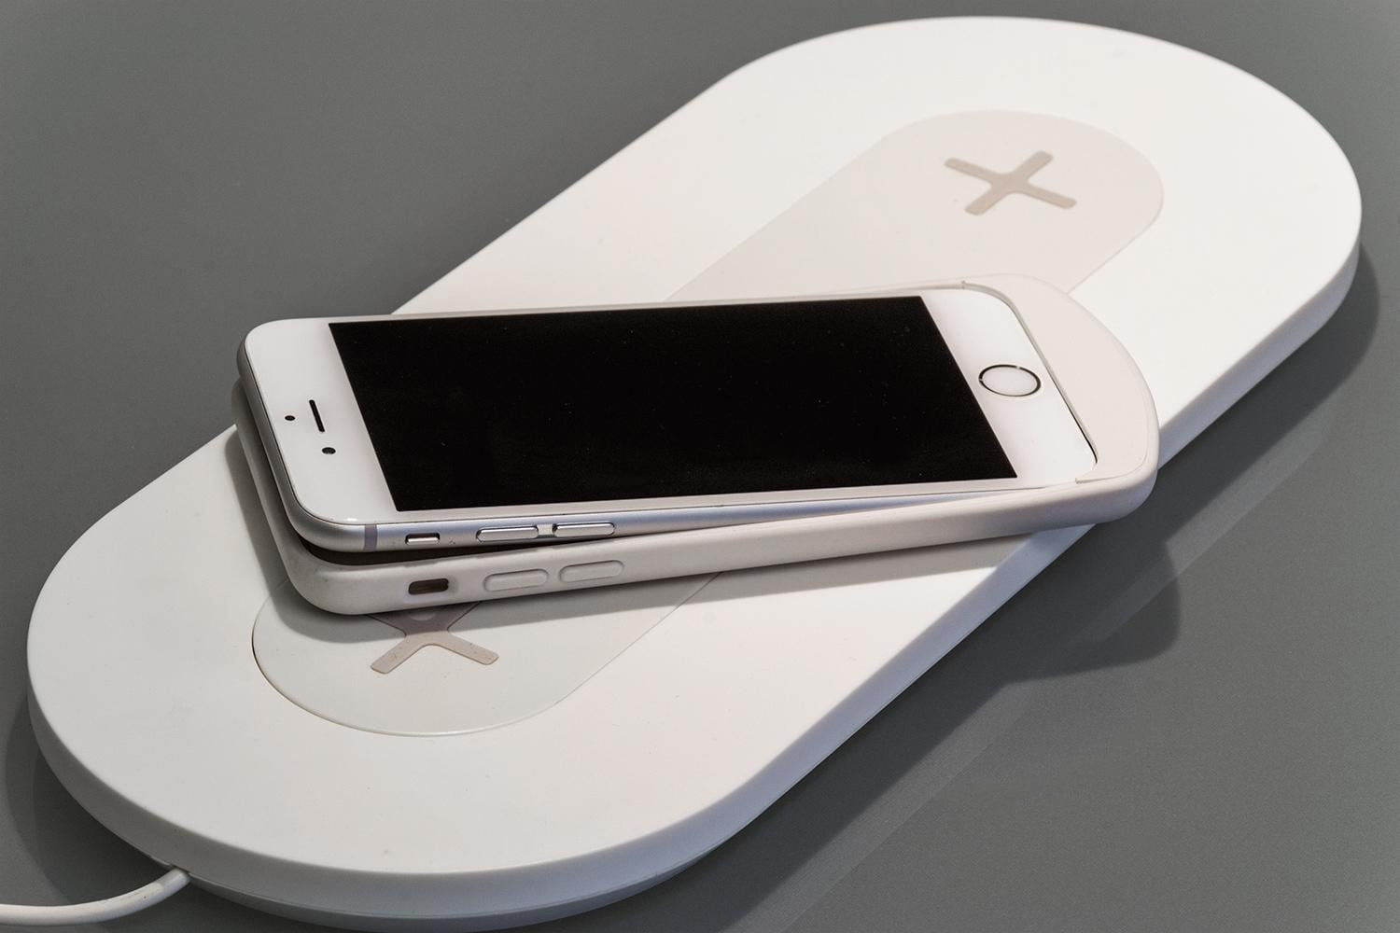
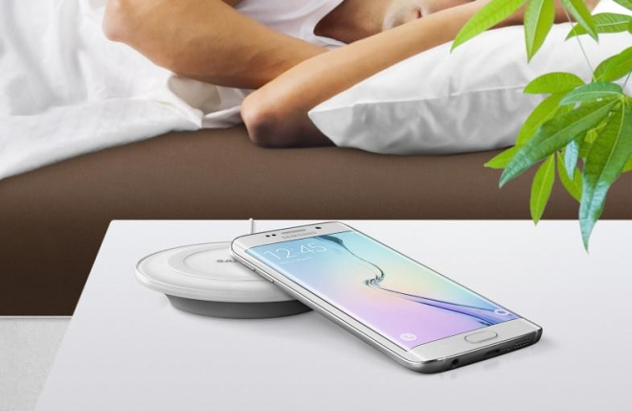
2017 Predictions: Batteries
Notes:
Predictions:
Drexel University College of Engineering was working on a special material called Mxene capable of instantly recharging.
Charge time was in the tens of milliseconds
Toyota was working on a solid state battery which would be available in cars by 2020. A solid-state battery would be much smaller and lighter and it would have an improved life. This technology is also being researched for mobile phones.
Sony was building a battery with 40% higher energy density
Wireless charging:
Market and Market predicted wireless charging market will be worth $13.7 billion.
Mashable predicted the iPhone will remove its final hole and go wireless charging by 2020. They state it is not a question of if … but when. Given the fact Apple has already removed the headphone port, it is likely they will remove the lightning port sooner rather than later.
Slash Gear reported GM had signed an agreement with WiTricity which will provide the capability to wirelessly charge its electric batteries.
Juniper Research estimated nearly 40% of households would adopt wireless charging by 2020.
The challenges:
Multi vendors with non compatible technology operating in the field.
Large focus is automotive technologies
May not be compatible with instant (or reduced) charging technologies.
Sources:
https://thenextweb.com/tech/2017/07/28/scientists-are-creating-a-cell-phone-battery-that-charges-instantly/#.tnw_7lDoXrC3
https://techcrunch.com/2017/07/25/toyotas-new-solid-state-battery-could-make-its-way-to-cars-by-2020/
http://www.thedrive.com/news/6402/five-minute-recharging-batteries-coming-early-as-2020
http://gizmodo.com/sonys-building-a-battery-with-40-higher-energy-density-1748668432
http://www.marketsandmarkets.com/PressReleases/wireless-charging.asp
http://mashable.com/2017/06/30/iphone-future-no-ports/#AQCZcEf0APqs
https://www.slashgear.com/gm-witricity-wireless-car-charging-partnership-21468305/
https://www.juniperresearch.com/press/press-releases/mobile-wireless-charging-40pc-households-by-2020
Actual:
Research continues for both Mxene and solid state batteries. Mxene shows promise and could be available in commercial products in the next 2-5 years. Solid state batteries unfortunately are decades away. Battery technology continues to improve with the increase of electric vehicles, advancements in mobile phone batteries, and emergence of new meta materials.
In 2019 - The global wireless charging market was valued at 9.72 billion
Source:
https://www.statista.com/statistics/1256342/worldwide-wireless-charging-market-revenues/
https://www.forbes.com/sites/neilwinton/2021/11/28/solid-state-batteries-promise-electric-car-popularity-boost-but-technical-mountains-await/?sh=6ef94905632f

Slide 15
2017 Predictions: Other devices/Tech
Drones
Internet of Things
Artificial Intelligence/Machine Learning
Automotive
Virtual/Augmented Reality
Notes:
These are some of the other areas we looked at:
Drones
Internet of Things
Artificial Intelligence/Machine Learning
Automotive
Virtual/Augmented Reality

Slide 16
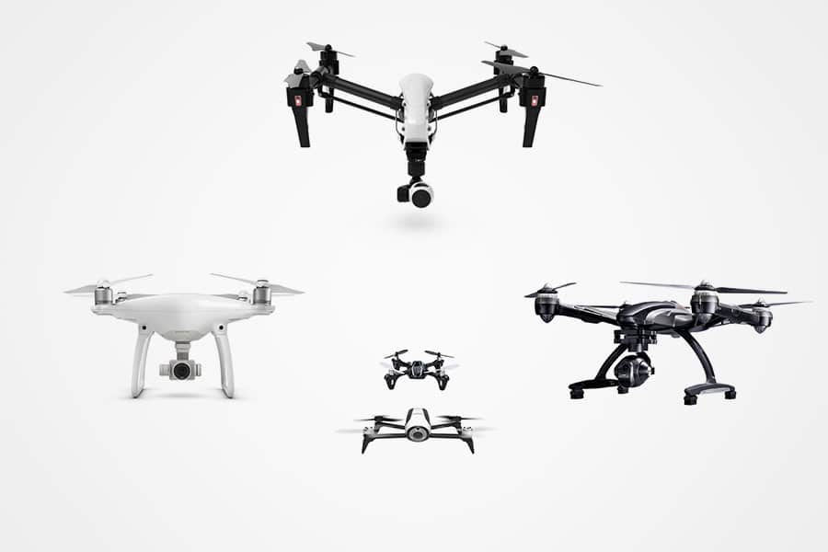
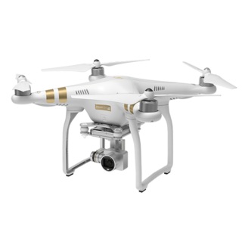
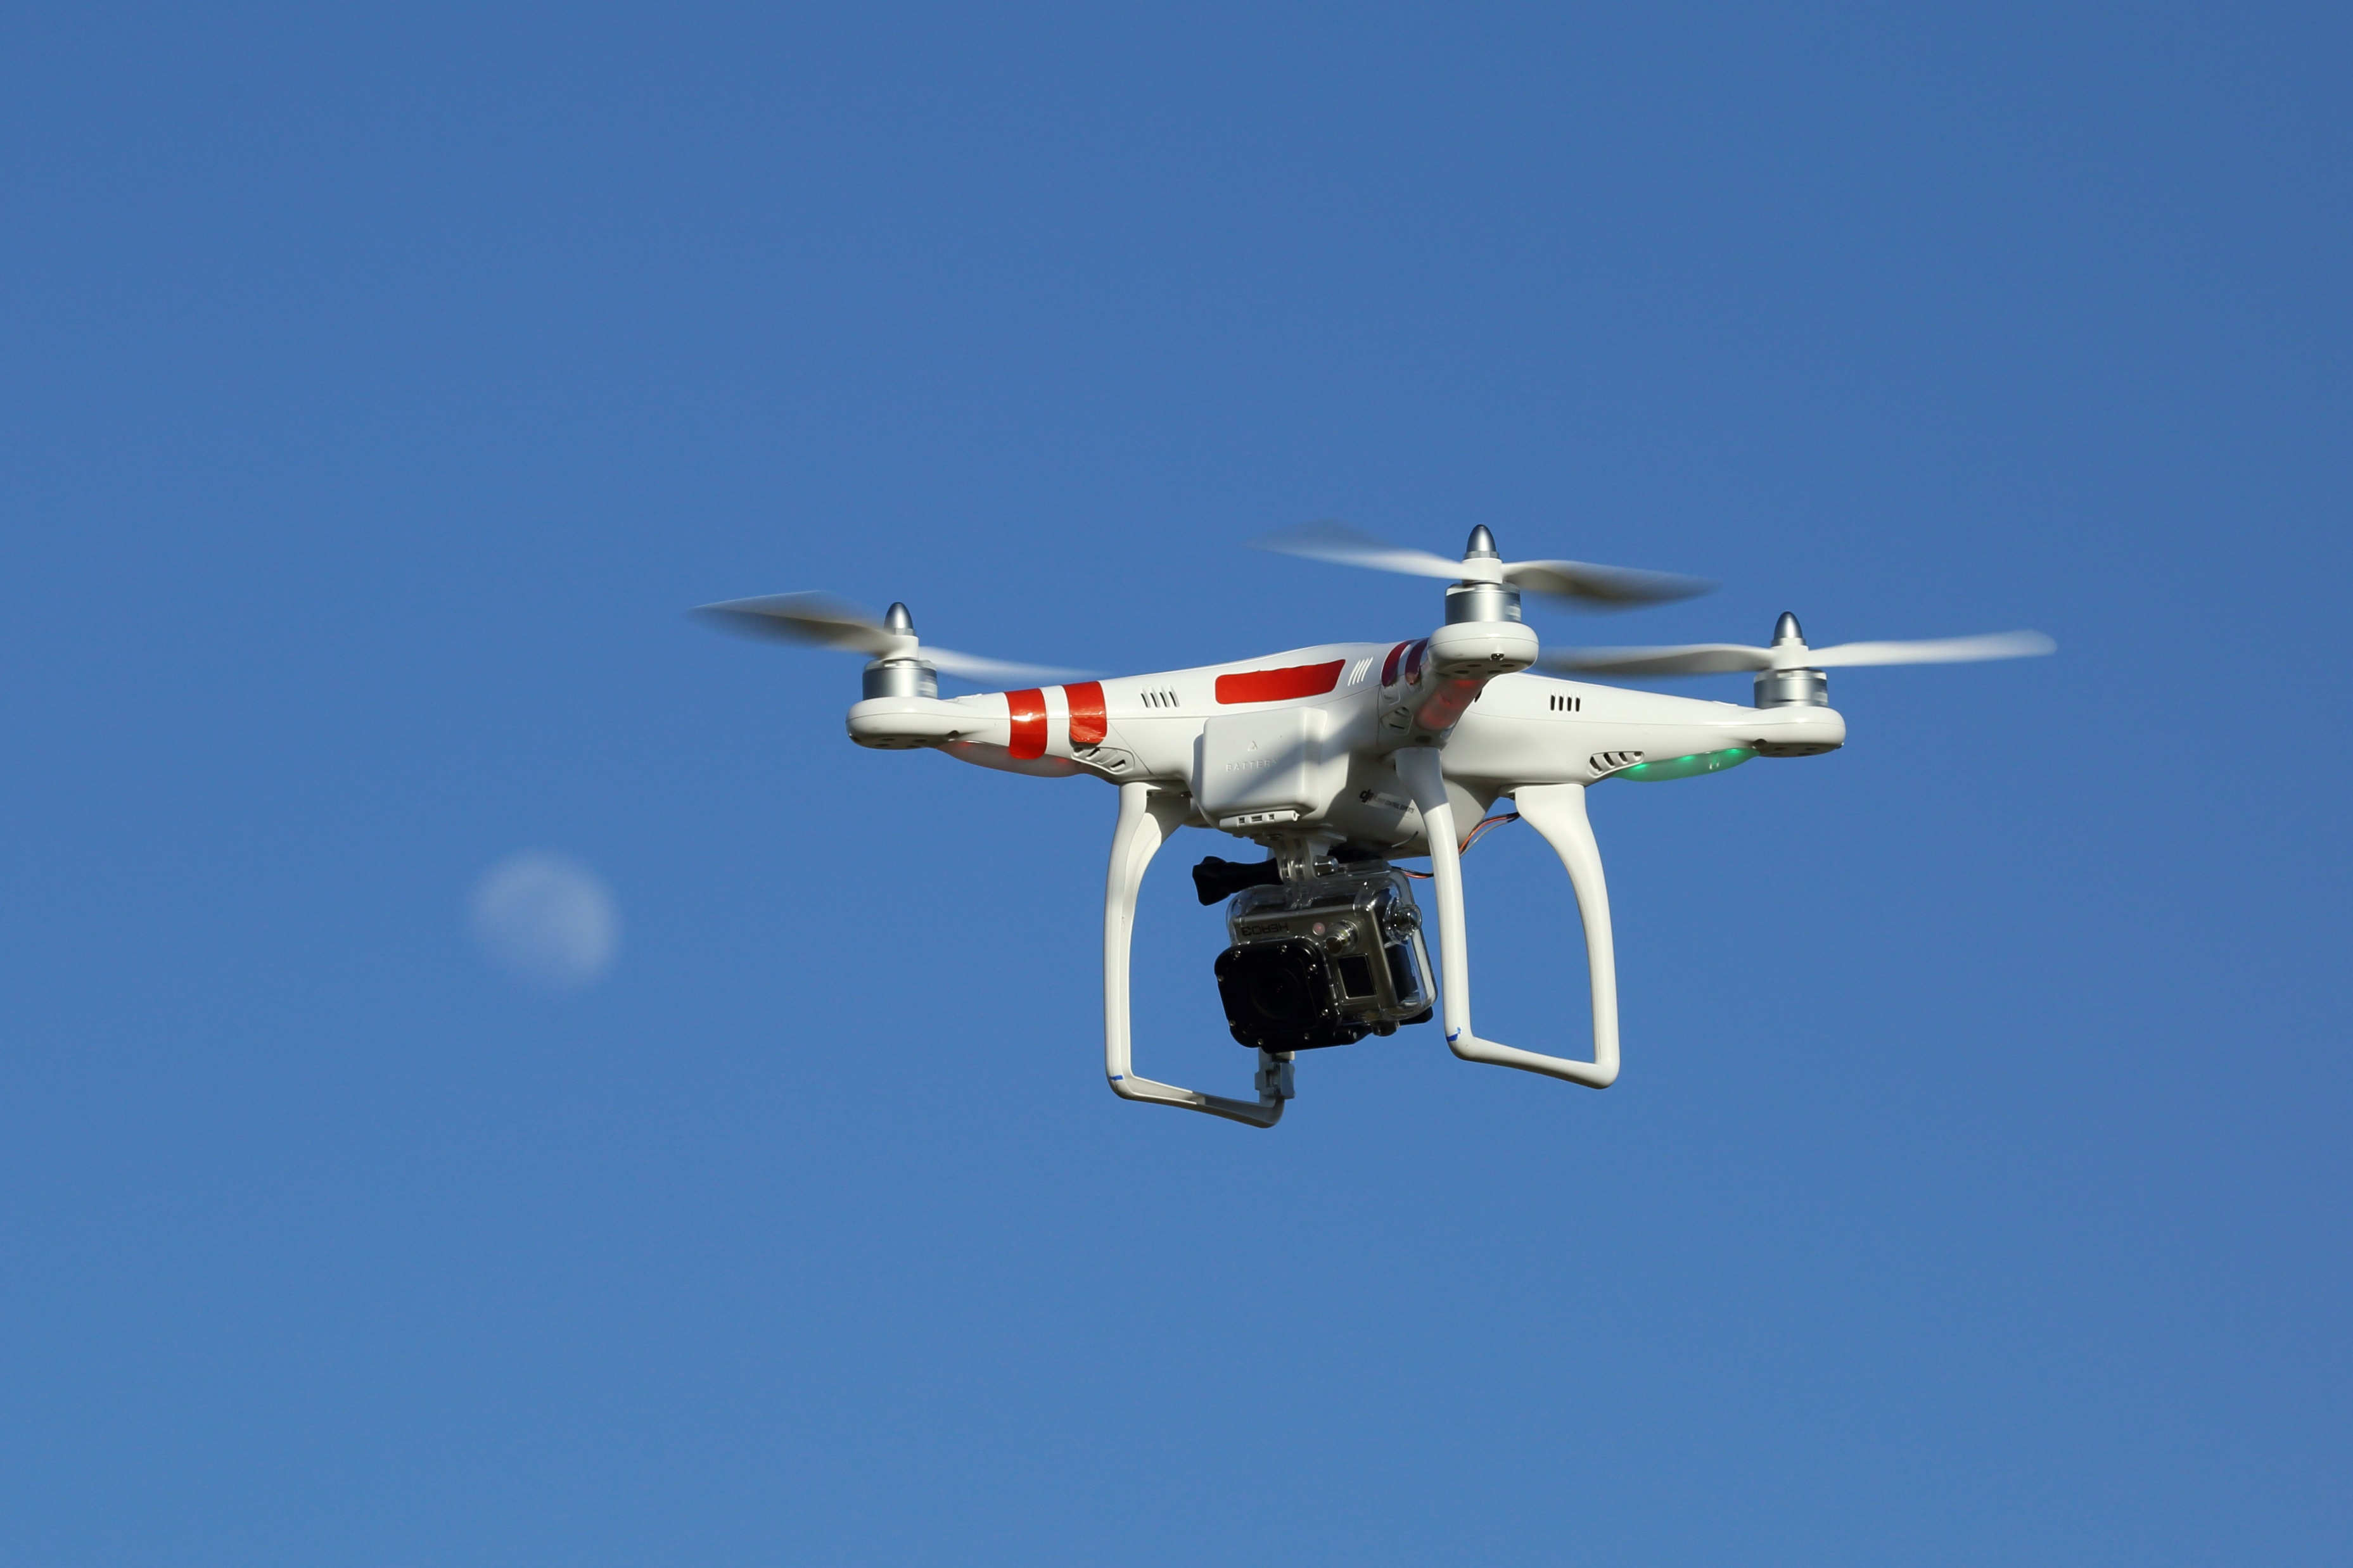
2017 Predictions: Drones
Notes:
Prediction:
FFA predicted there wouldl be over 7 million drones flying over America by 2020.
At the time, there were 2.5 million drones flying over America.
Uber plans on offering flying taxis using Vertical Take of and Landing (VTOL) drones in Dallas and Dubai by 2020.
Goldman Sachs notes drones have evolved from a strictly military application to a commercial application similar to GPS and the Internet.
Goldman Sachs notes drone technology will be a $70 billion industry by 2020. They note drones are already in use generating climate data, monitoring the borders and more.
Goldman Sachs notes drones will be able to support multiple fields:
Construction $11.1 billion
Agriculture $5.9 billion
Insurance Claims $1.4 billion
Offshore Oil/Gas Refining $1.1 billion
Police $885 million
Fire $881 million
Many others ranging from Coast Guard to Journalism to Border Patrol, Real Estate, Utilities, Pipelines, Mining, and Cinematography
Drones will be used in applications where it is too dangerous or too costly for humans/aircraft. Fire fighting water delivery targeting, inspections (pipes, electrical, etc).
Inspect crops in the field. Inspect 1,000 acres per day
Sources:
https://www.google.com/url?sa=t&rct=j&q=&esrc=s&source=web&cd=1&cad=rja&uact=8&ved=0ahUKEwiW6Nqvit3VAhXq44MKHd1PDfAQFggoMAA&url=http%3A%2F%2Fwww.popsci.com%2Fnew-faa-report-stares-in-face-drone-filled-future&usg=AFQjCNGy9LEhREf44hHOYTv8MeQHMtgCjg
http://www.dailymail.co.uk/sciencetech/article-4444874/Uber-looks-soar-flying-taxis-2020.html
http://www.goldmansachs.com/our-thinking/technology-driving-innovation/drones/
Actual:
According to the FAA, there are close to 1 million drones registered in the US. This does NOT include hobbyist.
Source: https://www.faa.gov/uas/resources/by_the_numbers/
No Uber UAVs … yet. Multiple countries have already started putting infrastructure into place to prepare for UAV taxis. In the US: Houston, Los Angeles, and Orlando have started work.
Source: https://www.bbc.com/news/business-58895259

Slide 17
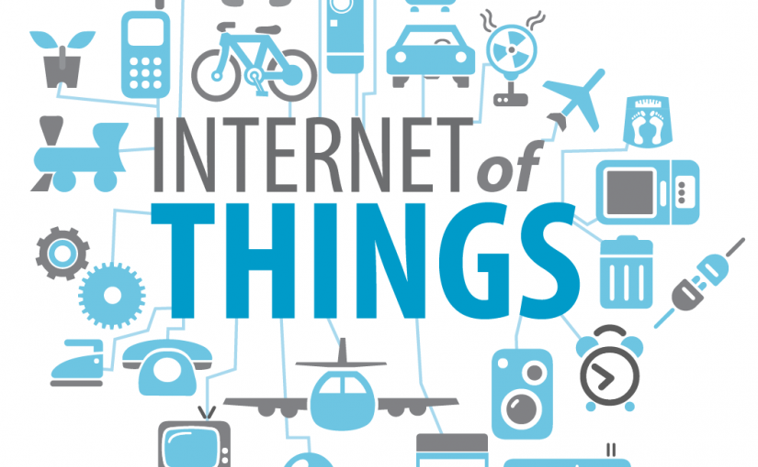
2017 Predictions: Internet of Things (IOT)
Notes:
Prediction:
Forbes predicted annual revenue from IoT wiouldreach $470 billion by 2020. The number of devices would grow from 15.4 billion in 2015 to 30.7 billion in 2020.
IoT has the potential to impact the economy by $2.7 – $6.2 trillion until 2025.
Enterprises have been adopted IoT to improve their operations. Examples include:
Transportation/Fleet
Security and Surveillance
Inventory and warehouse management
Gartner says 8.4 billion devices will be connected in 2017. That number will rise to 20.4 billion by 2020.
Sources:
https://www.forbes.com/sites/louiscolumbus/2016/11/27/roundup-of-internet-of-things-forecasts-and-market-estimates-2016/#64795063292d
http://www.gartner.com/newsroom/id/3598917
Actual:
In 2020, there was $389 billion in revenue for IoT
Source: https://www.statista.com/statistics/1194709/iot-revenue-worldwide/
In 2020, there were 8.74 billion IoT devices. This number continues to grow with the growth of ”Smart” devices and digital assistants (Echo - Alexa)
Source: https://www.statista.com/statistics/1183457/iot-connected-devices-worldwide/#:~:text=Number%20of%20IoT%20connected%20devices%20worldwide%202019%2D2030&text=The%20number%20of%20Internet%20of,China%20with%203.17%20billion%20devices.

Slide 18


2017 Predictions: Artificial Intelligence/Machine Learning
Notes:
Prediction:
Gartner said AI would be in almost every new software product by 2020.
ZDNet stated cognitive and artificial intelligence systems would reach $12.5 billion by the end of 2017. That number would rise to $46 billion by 2020.
Already being used in services like Microsoft’s Cognitive Services which can analyze a photo and provide information about the photo: what is in the photo, emotions of humans in photos, describe actions in photos, etc.
Challenges:
Unsupervised learning – currently learn through a structured force-feeding. Some systems have already started the process. In some cases, the company has shut down the system as the machines learned in ways humans could not understand.
Creativity and abstract thinking – currently computers struggle in this area, but with deep thinking computers may be able to cross this threshold by 2020.
Public trust – Only 39% of the public trusts AI
Integration – AI needs to integrate with something practical.
General use – currently designed for specific tasks. Need to develop so AI can serve a general purpose. Currently being used in applications like Siri, Google Home, Amazon Alexa, Cortana
Sources:
http://government-2020.dupress.com/driver/artificial-intelligence/
https://www.forbes.com/sites/joemckendrick/2017/03/30/artificial-intelligence-will-make-its-mark-within-next-3-years/#2b52cf446d49
http://www.gartner.com/newsroom/id/3763265
http://www.zdnet.com/article/cognitive-and-artificial-intelligence-spending-expected-to-surge-through-2020-says-idc/
Actual:
In 2020, AI investment reached $68 billion.
Source: https://www.statista.com/statistics/941137/ai-investment-and-funding-worldwide/
One source indicated venture capitalist invested $75 billion in 2020.
Source: https://venturebeat.com/2021/09/30/vcs-invested-over-75b-in-ai-startups-in-2020/#:~:text=According%20to%20the%20findings%2C%20the,nearly%20%2475%20billion%20in%202020.&text=The%20report%20also%20found%20that,reaching%20%2442%20billion%20in%202020.

Slide 19
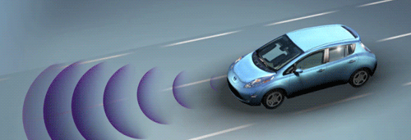
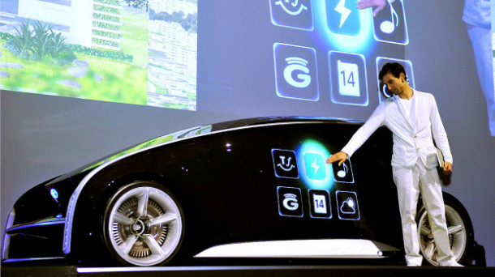
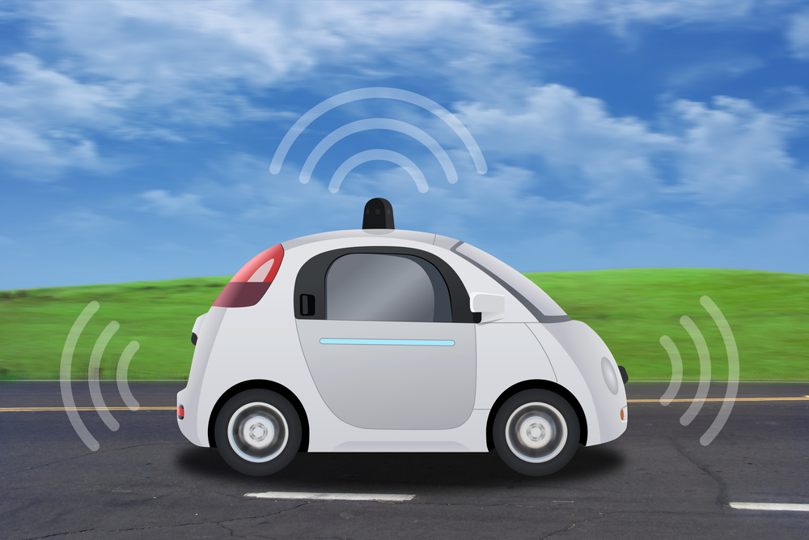
2017 Predictions: Automotive
Notes:
Predictions:
Forbes, TechCo, and Goliath all predicted similar technologies by 2020 for the automotive industry. The list includes:
Autonomous vehicles – fully autonomous in certain area/under certain weather conditions
Driver override systems – take over for safety
Biometric vehicle access -
Comprehensive vehicle tracking – insurance companies will offer reduced rates to track your driving habits
Active window display – navigation, early warning, highlight low visibility obstacles
Remote vehicle shutdown – stop stolen cars in their tracks, ending police chases
Active health monitoring – ranging from monitor sleepy drivers to people with a heart attack (automatically pull over and call for help)
Four cylinder supercar – Currently have a V6 with over 600 horse power. By 2020, with lightweight composite material, we will have a supercar capable of over 200 mph with a 4 cylinder
Reconfigurable body parts – convert from truck to SUV
Smartphone integration
Car-to-car communication – alert one another to accidents, road blocks, or even bad weather
Sources:
https://www.forbes.com/sites/kbrauer/2015/01/19/top-10-advanced-car-technologies-by-2020/#46ee3ece6705
https://tech.co/top-10-advanced-car-technologies-2020-2015-09
http://www.goliath.com/auto/10-amazing-new-car-technologies-we-expect-by-2020/
Actual:
We do not have fully autonomous vehicles yet. Kelly Blue Book describes 6 levels of autonomous capabilities:
0: No self driving capabilities. May have sensors, but 100% human driving
1: Slight intervention. Help keep you in your lane
2: Multiple autonomous systems: keep you in lane, adjust speed. Still require human driver. This is the most advanced in the US so far.
3: Car can drive itself under limited circumstances. Honda 100 Legend 1st Level 3 – limited to Japan
4: Car can drive itself in fixed loops or known roads.
5: Car can drive itself under any condition on any road
Source: https://www.kbb.com/car-advice/self-driving-cars/

Slide 20
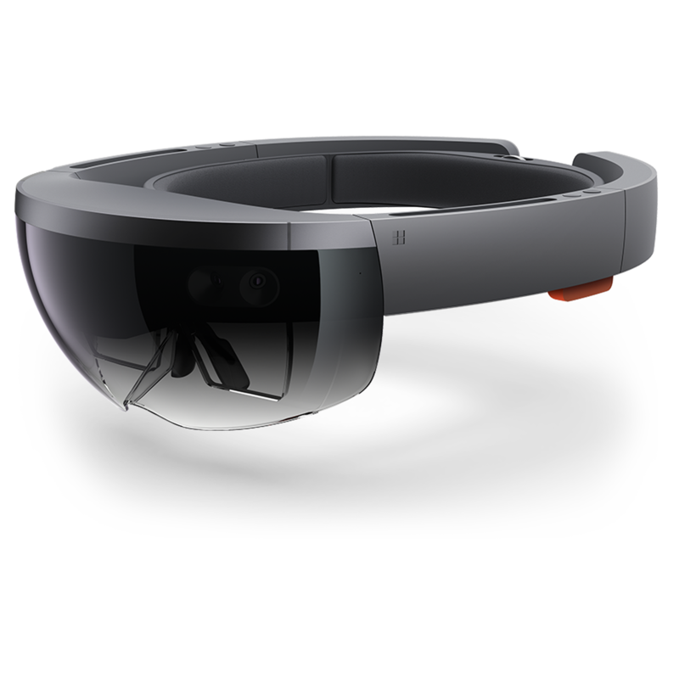
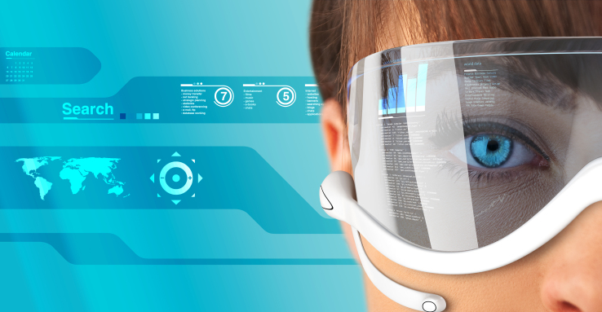
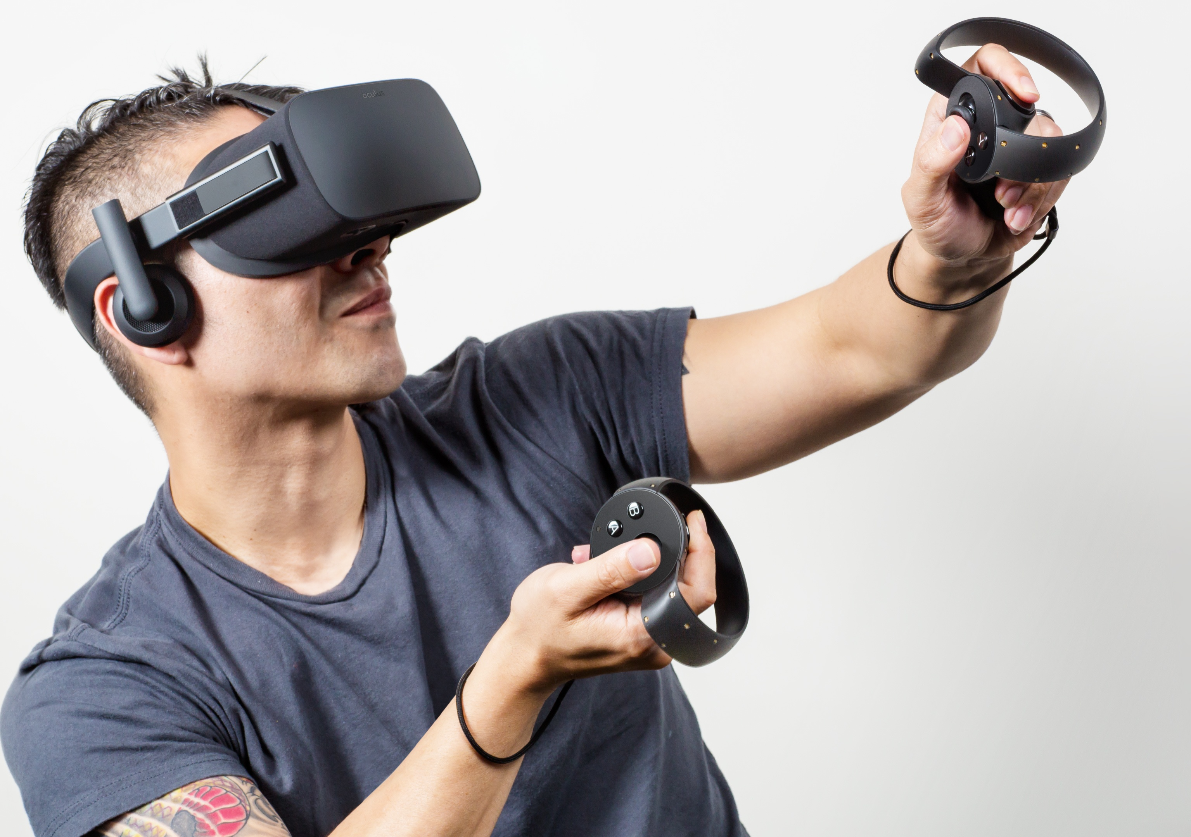
2017 Predictions: Virtual/Augmented Reality
Notes:
Prediction:
Gartner predicted by 2019 AR/VR/MR would be adopted by 20% of large-enterprises.
Fast Company predicted AR & VR would generate $150 billion in revenues by 2020. $120 million from AR and $30 million from VR.
Facebook purchased Oculus VR
Magic Leap had received over $592 million from investors like Google
Lensar - $131 million in funding
Nantmobile - $110 million in funding
JauntVR - $100 million in funding. Disney put in $65 million
Business Insider predicted VR & AR would reach $162 billion by 2020.
Sources:
http://www.businessinsider.com/virtual-and-augmented-reality-markets-will-reach-162-billion-by-2020-2016-8
https://www.fastcompany.com/3052209/vr-and-augmented-reality-will-soon-be-worth-150-billion-here-are-the-major-pla
http://www.gartner.com/smarterwithgartner/transform-business-outcomes-with-immersive-technology/
Actual:
In 2020, $18.8 billion in investment for AR/VR/MR
Source: https://www.nasdaq.com/articles/a-multibillion-dollar-trend%3A-when-virtual-reality-meets-augmented-reality-2020-11-17
More than just games: growth in manufacturing, medical, engineering. Used for training, designing, and communication.

Slide 21
Expert predictions 5- 10 years
Mobile Devices
Drones
Internet of Things
Artificial Intelligence
Notes:
Now that we have looked back at the past experts’ predictions, lets look forward to the experts’ future predictions. These are the four areas we will look at.

Slide 22
Mobile 5 – 10 years
Small incremental changes
Wearables
5G – Edge computing
Flip, fold, bend
New Interactions
Notes:
Most experts say the mobile phone will continue to evolve with small incremental changes. There is debate amongst the experts about what this will eventually lead too. Some predict little innovation or change claiming we have reached the technological maturity point. Other experts claim the smart phone will slowly change as users embrace wearable technologies. They claim users will interact with their wearables versus the actual smart phone.
The majority agree that wearables will continue to see major growth, more user adoption, and potential for new user interactions. Several large tech companies are investing heavily in this area as they see it as the next progression in user personal technology. Meta (formerly Facebook) has invested heavily in AR/VR. Apple has invested heavily in its wearable tech and rumors abound they will introduce new wearable tech. Apple Glasses?
Experts predict that 5G will increase Edge computing, making our devices the hardware at the edge. We will continue to have the Cloud, but tech companies are moving some of their computations closer to the edge of user interaction. With 5G, many tech companies will be able to bring the edge to your phone or wearable.
Many experts predict our mobile phone and our wearables will be made to fold, bend, or stretch to accommodate users. Mobile flip phones are now available. There have been major advancements in new meta material which will provide flexibility and stretchability to our devices. While viable, many manufacturers are looking for ways to automate the process and make it affordable. We will see the rise of 2nd generation bendable devices.
Some experts predict we will have new interactions with our mobile devices. These experts predict our mobile phone will identify and communicate with IoT devices in our environment. These IoT devices will communicate information to our mobile device which in turn will interact with our wearables, send notifications, and provide users information. Example: Users walking through a grocery store can view important information about a product they are looking at either through their phone or an AR device. The information can include what the average temperature an item was stored at, or recipes, items still in stock but not on shelves. Manufactures can look at a machine and see core information: operating temperature, cycle time, current operations, next scheduled maintenance, etc.
We are on the edge of a convergence where mobile devices, wearables (including AR/VR), faster connections (5G), Edge Computing, and AI are available and leveraged to develop new user experiences. Just like the convergence of technologies which led to smart phones, we may see the adoption of a new set of technology in the way humans interact with personal devices.
Sources:
https://www.forbes.com/sites/forbestechcouncil/2020/01/29/nine-tech-experts-share-their-predictions-for-the-future-of-smartphones/?sh=24bfdd8f4020
https://www.techradar.com/news/what-could-your-future-smartphone-look-like-in-2030
https://www.theverge.com/22749341/smartphones-future-predictions
https://internetofthingsagenda.techtarget.com/feature/IoT-and-mobile-app-development-transform-the-future-of-UX

Slide 23
Drones
AI Powered
Uber / Taxis
Expanding Areas : Agriculture – Disaster Response – Logistics
Military
More Regulation
Notes:
Experts in this area predict a rise in the number of drones, their uses, and the different areas where they will be used.
One of the major changes is the inclusion of AI in drones. Drones can be challenging to fly in normal conditions. To handle complex environmental challenges, drone manufacturers have embraced artificial intelligence to help pilot drones. AI can provide assistance when dealing with the different types of terrain, weather conditions, and operator experience. Much like AI has improved automotive driving, AI will improve the experience for operating drones.
Uber has committed to providing UAVs as part of its services. It had originally planned to launch the service in 2020 for Dubai and Dallas. Technical, logistical, and regulatory challenges have delayed their launch. However, Uber is committed to providing electronic VTOL taxis. Joby Aviation acquired Uber Elevate in December 2020 agreeing to integrate their services together to provide seamless aerial and ground transportation services, In June 2021. Joby partnered with America’s largest parking garage operator to create new parking parking spots for urban air taxis.
Additionally, the use of drones has grown to include several areas. California University noted the following areas where drones were being used and will see growth:
Agriculture: The Environmental Protection Agency already utilizes drone technology to manage livestock and survey crops. In the future farmers and ranchers could use unmanned aircraft to strategically monitor and spray their crops.
Conservation: Unmanned aircraft are being used to monitor endangered species and map the changes in various ecosystems around the globe. As drone technology advances, the use and impact of unmanned aircraft in conservation efforts will expand.
Delivery/fulfillment: Anything the postman can carry can also be delivered by drone. Food, prescriptions, that last-minute birthday gift for your dad—in the near future, there will be big changes in the way packages arrive to our doors.
Disaster mitigation and relief: Drones can go places that humans can’t access, so they are an ideal solution for dangerous search and rescue efforts, as well as for delivering emergency supplies to remote locations and disaster areas.
Logistics: Heavy-duty drones can replace trucks for inventory management and moving goods between warehouses. This is likely to decrease the number of semis you see on the road.
Filmmaking and photography: Low-budget filmmakers are already using drones to capture the aerial shots and Hollywood will soon be hiring full crews of drone operators. Unmanned aircraft are also gaining ground with photojournalists who want to capture breaking news from above.
ISPs: Big tech companies like Facebook and Google are experimenting with solar powered drone technology to beam Internet to remote locals. This could transform connectivity as we know it.
Law enforcement: In Seattle and Miami, police forces have already applied for permits to use drones, and we’ll likely begin to see unmanned aircraft supplementing police presence at large public events.
Real Estate: Real Estate listings are poised to change completely with high-definition videos capture by drones that fly through neighborhoods, and into every room in a listed house.
China utilizes drones to inspect power lines in many of its mountainous areas where it is difficult for humans to reach. Equipped with multiple sensors and cameras, the drones can inspect powerlines and support structures in a fraction of the time it would take a human to do the work. Imagine using drones to conduct inspections on bridges, skyscrapers, underwater utility lines.
Militaries continued to make significant investments and advancements in drone technology. Iran uses drones to target internal threats and protect external interests. Sweden announced drone sightings over three nuclear plants. Future of uses of drones by military includes intelligence gathering, surveillance, delivery of munitions, drone swarms, and even kamikaze style drones.
It is clear, drones have moved past toys and things that hobbyist tinker with.
Sources:
https://www.forbes.com/sites/forbestechcouncil/2021/06/30/the-future-of-drones-outer-space-urban-landscapes-and-business-tasks/?sh=7447957ce5d5
https://www.calu.edu/academics/undergraduate/associate/drone-technology/future-drone-technology-and-uses.aspx
https://www.businessinsider.com/drone-technology-uses-applications
https://www.popularmechanics.com/the-future-of-drones/
https://www.uber.com/us/en/elevate/
https://www.gearbrain.com/uber-passenger-drone-flying-taxi-2649420674.html
https://dronelife.com/2021/06/11/joby-aviation-inks-major-deal-to-snag-parking-spots-for-urban-air-taxis/
https://www.rferl.org/a/iran-drone-program-threats-interests/31660048.html
https://www.bbc.com/news/world-europe-60035446
https://www.defensenews.com/opinion/commentary/2021/05/25/weapons-of-the-future-trends-in-drone-proliferation/

Slide 24
Internet of things
+25 billion devices by 2025
Mobile app interaction -> access from any device
AR/VR
IoT devices provides information, notifications, and real time interactions with our world
Notes:
Experts predict we will have over 25 billion IoT devices connected by 2025. Put into perspective, the current human population in the world is 7.9 billion. That will be 3 IoT devices for every human being on the planet.
This growth will be fueled by many cities and companies adopting smart technologies to save time and money. While we still have smart thermostats and digital assistants, IoT devices will move more towards an infrastructure layer. What does this mean? We will move past mobile app interaction to services that can be accessed via any connected device. Services like Pandora and Spotify can be accessed via your mobile phone, Alexa, Smart TV, automobile, and even smart refrigerators. In the future, you will be able to access DropBox files wherever you are, not because you can access it via mobile, but because DropBox will be available on any device. These changes will reach VR/AR devices and other wearables.
IoTs will provide information, notifications, and provide real time interactions with our real world. By leveraging 5G, AI, and Edge computing, IoT devices will change the way we interact with technology and our world. Imagine a world where your furnace and/or thermostat contacts you that is experiencing an issue and based on the current and future weather conditions recognizes it needs to be fixed. It even provides suggestions and will schedule the appointment for you … and this might not even be done on your phone, but your car audio as you are driving, or your gaming system as you are relaxing, or your AR headset as you are traveling.
Sources:
https://us.norton.com/internetsecurity-iot-5-predictions-for-the-future-of-iot.html
https://www.project-disco.org/innovation/110117-hot-new-tech-everything/?gclid=Cj0KCQiAip-PBhDVARIsAPP2xc3pykgJjw-BgkWybKA_VgbVETTNADRHt-FuDhUFl8oHq713RAHXrfoaAtJ1EALw_wcB
https://worldpopulationreview.com/
https://www.weforum.org/agenda/2021/03/ai-is-fusing-with-the-internet-of-things-to-create-new-technology-innovations/

Slide 25
Artificial Intelligence
Healthcare
Business sustainability
Ethics & Governance
Service Innovations
Notes:
Artificial Intelligence is being used in simple processes today. It may be a simple chatbot to help a user resolve an issue on the web. It may be used to model the weather for the next 7-10 days. It can be used to learn how to solve a problem (machine learning/deep learning). While we have not evolved to HAL in a Space Odyssey or Jarvis in Marvel’s cinematic universe, we are making major advancements in AI … and that will continue to grow. Graphical processing units (GPU) are making way for Application-Specific Integrated Circuits (ASIC) and Field Programmable Gate Array (FPGA). This is because both ASIC and FPGA showcase better performance than GPU.
With the emergence of 5G and the growth of IoT devices to provide more real-time data, AI will be able to leverage its new hardware to do more than simple processes. Experts predict by 2030, AI will significantly change healthcare. AI will use data from a patient’s full genomic data, real time monitoring devices, and integrated health-service data to provide precise medical treatments specifically designed for the individual patient. In addition, AI will may help detect more health issues with greater accuracy.
Experts in this field predict AI will help businesses identify and implement processes to achieve a carbon neutral organization. A Microsoft and PWC report highlights that AI used in sustainability-related contexts could add up to $5.2 trillion USD to the global economy in 2030. Organizations can utilize AI and IoT devices to identify ways to reduce and eliminate waste and energy.
To build trust and protect the world from Skynet and the Terminator, governments must adopt regulations and standards to promote transparency. This year, the United States Federal Trade Commission published guidelines for ‘truth, fairness, and equity’ in AI use, and the European Commission released its recommendations for AI regulation. Both stress the need for transparent AI accountability. UQ’s Trust Ethics and Governance Alliance research hub predicts that by 2035, organizations will be required to provide transparent reports on their use of AI and data and will be held to high ethical standards
Experts predict by 2050, machines will be able to read emotions and be able to provide personal experiences to meet customer expectations. Services exist today where AI can take a photo as input and then output what is happening in the photo along with each individual’s mood.
Sources:
https://business.uq.edu.au/momentum/4-ways-ai-will-revolutionise-the-world
https://www.forbes.com/sites/forbesbusinesscouncil/2021/08/23/the-possibilities-of-ai-in-2030-transformation-across-dimensions/?sh=5aa5ced66b67

Slide 26
Information Technology’s Role
Integrating new devices/technology
Collecting data => Providing Information
Security
Notes:
While there are many more technologies worthy of our attention, due to time constraints we will limit this discussion to the four areas we have already discussed. However, I would be remiss if I did not talk about IT’s role with these evolving technologies.
As new devices and new technologies emerge, IT must plan, implement, and maintain integrations with these new technologies. While vendors provide services and data, it will be up to IT to integrate into the organization’s ecosystem. How will this new device interact with existing data? What processes will change? What can break? How do we detect failures? How do we fix failures? How do we minimize the impact of failures? The answers will depend on each organization’s needs. Example: if an IoT device that is responsible for reporting temperatures starts to send extreme values, what does the organization want to do about it? Will there be code in place to prevent logging of this data? Will there be alerts to fix? Some organizations may want to keep data on the failures to track frequency and severity. Others may not/
One thing is certain, the role of IT is evolving. We are shifting from the role of IT as an enabler to IT as a major component to an organization. IT must be able to collect larges amounts of data and provide information to the organization. Gartner notes CEOs want three things: Growth, digitalization and efficiency. To achieve this, Gartner stated IT should embrace three force-multiplying innovations to accelerate growth and strategically drive their organization forward:
Trusted digital connections for your people and devices everywhere
Solutions to rapidly scale digital creativity anywhere
Innovative capabilities to accelerate business growth beyond today
McKinsey predicts many emerging technologies will converge to provide new break throughs in understanding, usage, and services. Many organizations are investing in multiple areas to achieve a competitive advantage and provide new capabilities and services. IT must be ready to integrate these new technologies or be prepared to fall behind.
While these new technologies will provide new benefits and help organizations achieve their goals, they bring new risks to an organizations. IT must carefully consider the new technologies to plan and implement security to protect their organization and their consumers. As the waterfront of devices continues to grow, so does the surface area for attacks grow. Hackers and cyber terrorist will exploit the new surface area to find the one weakness to gain entry into an organization. Additionally, these nefarious groups will employ new techniques to attack an organization: planting rogue IoT devices, using an IoT army to cripple services, collect and exploit data. We can know longer think of security as the next step in implementation. It must be part of the original decision-making process when building or integrating new technology and devices. Security continues to evolve with thinks like Cybersecuirty meshes, AI intrusion detection systems, and connected monitoring systems. It is IT’s responsibility to protect the organization and their consumers.
Sources:
https://emtemp.gcom.cloud/ngw/globalassets/en/publications/documents/2022-gartner-top-strategic-technology-trends-ebook.pdf
https://www.mckinsey.com/business-functions/mckinsey-digital/our-insights/the-top-trends-in-tech
https://emtemp.gcom.cloud/ngw/globalassets/en/publications/documents/2022-gartner-top-strategic-technology-trends-ebook.pdf

Slide 27

Questions
Notes:
Thank you all for your time and your attention. I will now open it up for any questions. It can be on any of the topics I discussed or other areas I did not discuss that you may be interested in.

